Slide 1
Computer Architecture I
CS-GY-6133
Topic: Pipelined MIPS
Instructor: Siddharth Garg

Slide 2
5 Stage Pipeline (with support for load/store)
Basic steps in executing an R-type instruction
Instruction fetch (IF)
Instruction Decode/Register File Read (ID/RF)
Execute in ALU (EX)
Load result from or store result to data memory (MEM)
Write-back Result to RF (WB)
Flip-Flop
ID/RF
(Decoder, RF)
Flip-Flop
EX
(ALU)
Flip-Flop
Flip-Flop
WB
(RF)
Flip-Flop
Flip-Flop
IF
(PC, Imem)
MEM
(Dmem)
CLK
CLK
CLK
CLK
CLK
CLK

Slide 3
t0
t1
t2
t3
t5
Time
IF
ID/RF
EX
MEM
WB
add $1, $2, $3
Read $1, $2
R[$1] + R[$2]
nop
Write $3
IF
ID/RF
EX
MEM
WB
lw $4 ,$5, imm
Read $4
Addr=R[$4] + SgnImm
Load from Addr
Write $5
IF
ID/RF
EX
MEM
WB
sw $6 ,$7, imm
Read $6, $7
Addr=R[$6] + SgnImm
Store R[$7]
to Addr
Nop
Instructions

Slide 4
RAW Hazards: Add-Add Dependency
t0
t1
t2
t3
t5
Time
IF
ID/RF
EX
MEM
WB
add $1, $2, $3
Read $1, $2
R[$1] + R[$2]
nop
Write $3
IF
ID/RF
EX
MEM
WB
add $3, $4, $5
Read $3, $4
R[$3] + R[$4]
nop
Write $5
EX-EX Forwarding (same as 4-stage pipeline)
Instructions

Slide 5
RAW Hazards: Add-Add Dependency
t0
t1
t2
t3
t5
Time
IF
ID/RF
EX
MEM
WB
add $1, $2, $3
Read $1, $2
R[$1] + R[$2]
nop
Write $3
IF
ID/RF
EX
MEM
WB
add $7 $8, $9
Read $7, $8
R[$7] + R[$8]
nop
Write $9
IF
ID/RF
EX
MEM
WB
add $3, $4, $5
Read $3, $4
R[$3] + R[$4]
nop
Write $5
Instructions
MEM-EX Forwarding

Slide 7
5 Stage Pipeline (with support for load/store)
Two forwarding paths
Same destination register in both forwarding paths? Pick data from EX-EX forwarding path
Forwarding Control Logic
R[rd] from prior to prior instruction
R[rd] from prior instruction
Flip-Flop
ID/RF
(Decoder, RF)
Flip-Flop
EX
(ALU)
Flip-Flop
Flip-Flop
WB
(RF)
Flip-Flop
Flip-Flop
IF
(PC, Imem)
MEM
(Dmem)
CLK
CLK
CLK
CLK
CLK
CLK

Slide 8
RAW Hazards: Add-Load Dependency
t0
t1
t2
t3
t5
Time
IF
ID/RF
EX
MEM
WB
add $1, $2, $3
Read $1, $2
R[$1] + R[$2]
nop
Write $3
IF
ID/RF
EX
MEM
WB
lw $3, $4, imm
Read $3
Addr = R[$3] + SgnImm
Load from Addr
Write $4
EX-EX Forwarding
Instructions

Slide 9
RAW Hazards: Add-Load Dependency
t0
t1
t2
t3
t5
Time
IF
ID/RF
EX
MEM
WB
add $1, $2, $3
Read $1, $2
R[$1] + R[$2]
nop
Write $3
IF
ID/RF
EX
MEM
WB
add $7 $8, $9
Read $7, $8
R[$7] + R[$8]
nop
Write $9
IF
ID/RF
EX
MEM
WB
lw $3, $4, imm
Read $3
Addr = R[$3] + SgnImm
Load from Addr
Write $4
Instructions
MEM-EX Forwarding

Slide 10
RAW Hazards: Load-Add Dependency
t0
t1
t2
t3
t5
Time
IF
ID/RF
EX
MEM
WB
lw $3, $4, imm
Read $3
Addr = R[$3] + SgnImm
Load from Addr
Write $4
IF
ID/RF
EX
MEM
WB
add $4, $5, $6
Read $4, $5
R[$4] + R[$5]
nop
Write $6
Will this work?
Solution: Stall the pipeline
Instructions

Slide 11
RAW Hazards: Load-Add Dependency
Solution: Stall the pipeline
t0
t1
t2
t3
t5
Time
IF
ID/RF
EX
MEM
WB
lw $3, $4, imm
Read $3
Addr = R[$3] + SgnImm
Load from Addr
Write $4
IF
ID/RF
ID/RF
EX
MEM
WB
add $4, $5, $6
Read $4, $5
Read $4, $5
R[$4] + R[$5]
nop
Write $6
IF
IF
ID/RF
EX
MEM
Instructions

Slide 12
RAW Hazards: Load-Add Dependency
MEM-EX Forwarding
t0
t1
t2
t3
t5
Time
IF
ID/RF
EX
MEM
WB
lw $3, $4, imm
Read $3
Addr = R[$3] + SgnImm
Load from Addr
Write $4
IF
ID/RF
EX
MEM
WB
add $7 $8, $9
Read $7, $8
R[$7] + R[$8]
nop
Write $9
IF
ID/RF
EX
MEM
WB
add $4, $5, $6
Read $4, $5
R[$4] + R[$5]
nop
Write $6
Instructions

Slide 13
RAW Hazards: Load-Store Dependency
t0
t1
t2
t3
t5
Time
IF
ID/RF
EX
MEM
WB
lw $3, $4, imm
Read $3
Addr = R[$3] + SgnImm
R[$4] = Mem[Addr]
Write $4
IF
ID/RF
EX
MEM
WB
sw $5, $4, imm
Read $5
Addr = R[$5] + SgnImm
Mem[Addr] = R[$4]
Write $9
MEM->MEM Forwarding
Instructions

Slide 14
Branch Instructions
t0
t1
t2
t3
t5
Time
IF
ID/RF
EX
MEM
WB
beq $3, $4, addr
Read $3, $4
R[$3]==R[$4]?
nop
nop
IF
Branch Taken/Not Taken not known till cycle T3!
Instructions

Slide 15
Solution 1: Stall+Flush
Fetch from PC+4 by default
t0
t1
t2
t3
t5
Time
Taken
IF
ID/RF
EX
MEM
WB
beq $3, $4, addr
Read $3, $4
R[$3]==R[$4]?
nop
nop
IF
ID/RF
EX
MEM
WB
PC+4
NOP
NOP
NOP
IF
ID/RF
EX
MEM
WB
PC+8
NOP
NOP
NOP
NOP
Instructions
ADDR
IF

Slide 16
Reducing Stall Penalty
t0
t1
t2
t3
t5
Time
IF
ID/RF
EX
MEM
WB
beq $3, $4, addr
Read $3, $4
nop
nop
R[$3]==R[$4]?
IF
Move branch comparison and target address calculation to ID/RF
Instructions

Slide 17
Solution 2: Moving Branch Calc to ID/RF Stage
t0
t1
t2
t3
t5
Time
Taken
IF
ID/RF
EX
MEM
WB
beq $3, $4, addr
Read $3, $4
nop
nop
nop
nop
R[$3]==R[$4]?
IF
ID/RF
EX
MEM
WB
PC+4
NOP
NOP
NOP
ADDR
IF
Instructions
Fetch from PC+4 by default

Slide 18
What About RAW Dependencies?
t0
t1
t2
t3
t5
Time
IF
ID/RF
EX
MEM
WB
add $1, $2, $3
Read $1, $2
R[$1] + R[$2]
nop
Write $3
IF
ID/RF
EX
MEM
WB
beq $3, $4, addr
Read $3, $4
nop
nop
nop
R[$3]==R[$4]?
Result needed in ID/RF stage at the same time it is being computed
Instructions

Slide 19
What About RAW Dependencies?
t0
t1
t2
t3
t5
Time
IF
ID/RF
EX
MEM
WB
add $1, $2, $3
Read $1, $2
R[$1] + R[$2]
nop
Write $3
IF
ID/RF
ID/RF
EX
MEM
WB
beq $3, $4, addr
Read $3, $4
Read $3, $4
nop
nop
nop
R[$3]==R[$4]?
R[$3]==R[$4]?
New EX->ID/RF Forwarding Path
Instructions

Slide 20
Reducing Stall Penalty Further: Branch Delay Slot
t0
t1
t2
t3
t5
Time
IF
ID/RF
EX
MEM
WB
beq $3, $4, addr
Read $3, $4
R[$3]==R[$4]?
nop
nop
R[$3]==R[$4]?
PC+4
IF
ADDR
IF
ISA specifies that the instruction following beq is always executed even if branch is Taken
Instructions

Slide 21
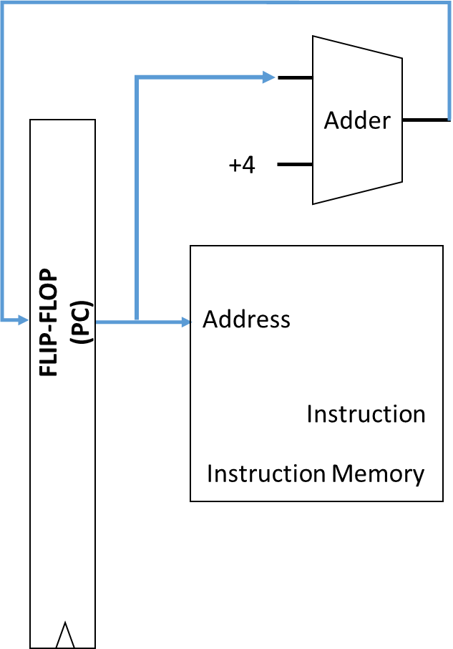
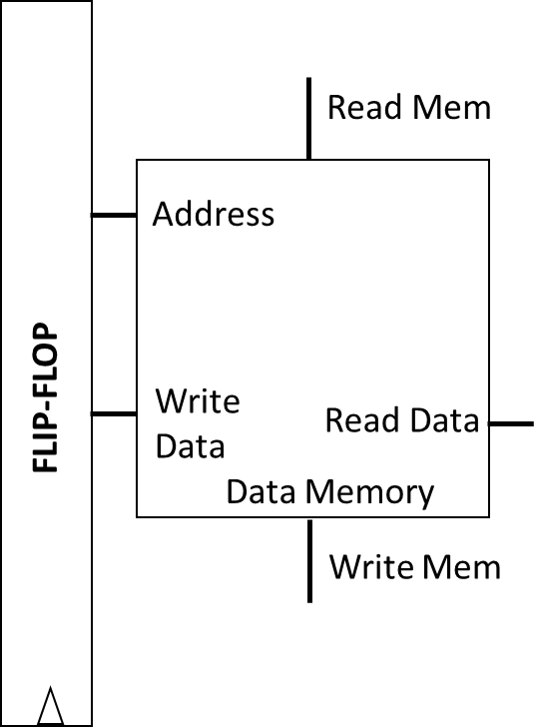
5-Stage Pipeline
Flip-Flop
ID/RF
(Decoder, RF)
Flip-Flop
EX
(ALU)
Flip-Flop
Flip-Flop
WB
(RF)
Flip-Flop
Flip-Flop
IF
(PC, Imem)
MEM
(Dmem)
CLK
CLK
CLK
CLK
CLK
CLK
How are Imem and Dmem implemented?
Note: simplified pictures of IF and MEM stages

Slide 22
Memory System
Processor
Flip-Flop
ID/RF
(Decoder, RF)
Flip-Flop
EX
(ALU)
Flip-Flop
Flip-Flop
WB
(RF)
Flip-Flop
Flip-Flop
CLK
CLK
CLK
CLK
CLK
CLK
Memory Controller
Main Memory
Dynamic Random Access Memory (DRAM)
(Unified instruction and data memory)

Slide 23
DRAM Details
3.6 GHz Pentium 4
Flip-Flop
ID/RF
(Decoder, RF)
Flip-Flop
EX
(ALU)
Flip-Flop
Flip-Flop
WB
(RF)
Flip-Flop
Flip-Flop
CLK
CLK
CLK
CLK
CLK
CLK
Memory Controller
Main Memory
Memory capacity: 4GB
Access Latency: 50 ns/word = ?? Clock cycles/word
= 50 ns / (1/3.6) ns = 180 cycles

Slide 24
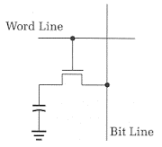
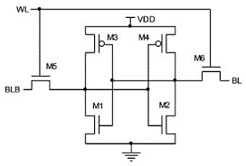
Memory Technologies
 | DRAM | SRAM (512 KB) | SRAM (4 MB)
Cell | 1 Transistor, 1 Capacitor (1T-1C) | 6 Transistor (6T) | 6 Transistor (6T)
Density (bits/um²) | High | Low | Low
Access Latency (ns) | Large | Small | Medium

Slide 25
Memory Hierarchy
Cache = “temporary storage space”
Instead of slow off-chip access to large DRAM, store frequently used data in on-chip SRAM cache
Hierarchy:
L1 Cache: small (32 KB), very fast (typically 1 clock cycle)
L2 Cache: larger (1 MB), slower (10s of nsecs)
L3 Cache: even larger ….
Main Memory: 4GB, 100s of nsecs
Decoder, RF, EX
CPU
SRAM
L1 Cache
SRAM
L2 Cache
DRAM Main Memory

Slide 26
Locality
Decoder, RF, EX
CPU
Temporal locality: if you’ve accessed some data, you’ll likely access it again in the near future
Same instructions are repeatedly accessed within loops
For example the loop counter
Spatial locality: if you’ve accessed some data, you’ll likely access nearby data
Array accesses
Instruction are accessed in sequential order
SRAM
L1 Cache
SRAM
L2 Cache
DRAM Main Memory

Slide 27
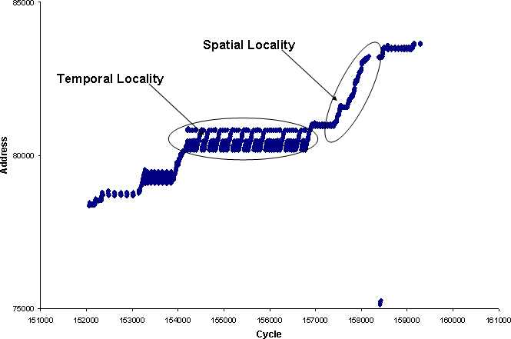
Access Pattern Exhibiting Locality
http://www.eetimes.com/document.asp?doc_id=1275470

Slide 28
Cache Organization
Caches store data in chunks of “cache blocks”
Access to a cache returns an entire cache block
A block can be as small as 1 byte, but can be larger (example: 4 bytes)
Where does a block go when it is fetched into cache? (Placement)
How do we know if a block already exists in the cache? (Identification)
Which block should we kick out if there isn’t enough room? (Replacement)
32 KB cache
1 Byte cache block
i.e., 32768 blocks
32 bit address
from CPU

Slide 29
Direct Mapped Cache
Assume 32 KByte cache with a 1 Byte cache block
1 Byte = 8 bits
Block 0
Address 0, 32768, 2*32768, …
Block 1
Address 1, 32769, 2*32768+1, …
Block 2
Address 2, 32770, 2*32768+2, …
32 bit address
from CPU
Block 32767
Address 32767, 65535, …

Slide 30
Direct Mapped Cache: Placement
Each block in the cache has a log₂(32768) = 15 bit “index”
Index
Block 0
Address 0, 32768, 2*32768, …
32 bit address
from CPU
Block 1
Address 1, 32769, 2*32768+1, …
Block 2
Address 2, 32770, 2*32768+2, …
Index
(15 bits)
15 LSBs of address are used to look up (index) into the cache
Block 32767
Address 32767, 65535, …

Slide 31
Direct Mapped Cache: Identification
32 bit address
Data Array
(8 bits)
Tag Array
(17 bits)
Tag
(17 bits)
Index
(15 bits)
Block 0
Tag 0
Addr 0
0…………………….00
0….00
Block 1
Tag 1
Addr 32768
0…………………….01
0….00
Block 2
Tag 2
How do we know which block of data is stored?
Addr ….
1…………………….11
0….00
Block 32767
Tag 32767

Slide 32
Direct Mapped Cache: Replacement
32 bit address
Data Array
(8 bits)
Tag Array
(17 bits)
Tag
(17 bits)
Index
(15 bits)
Data[0]
0…………… 00
Data[32768]
Tag 0
Block 0
0…………… 01
Access 1
0…………………….00
0….00
Miss
Block 1
Tag 1
Data[1]
0…………… 00
Access 2
0…………………….00
0….00
Hit
Block 2
Tag 2
Access 3
0…………………….01
0….00
Miss
Access 4
0…………………….00
0….01
Miss
Block 32767
Tag 32767

Slide 33
Direct Mapped Cache: Replacement
32 bit address
Data Array
(8 bits)
Tag Array
(17 bits)
Valid
(1 bit)
Tag
(17 bits)
Index
(15 bits)
Data[0]
1
Data[32768]
Tag 0
Block 0
0…………… 00
0
Access 1
0…………………….00
0….00
Miss
0
Block 1
Tag 1
1
Data[32769]
0…………… 01
Access 2
Block 2
Tag 2
0…………………….00
0….00
Hit
Access 3
0…………………….01
0….00
Miss
Block 32767
Tag 32767
0

Slide 34
Cache Operation
Data Array
(8 bits)
Tag Array
(17 bits)
Valid
(1 bit)
Address (32 bits)
Tag
(17 bits)
Index
(15 bits)
Block 0
Tag 0
V 0
0
Block 1
Tag 1
0
V 1
Block 2
Tag 2
V 2
Block 32767
Tag 32767
V..
1
=
&
0
0
MISS
Output Data if HIT
1
HIT

Slide 35
Alternative Placement
Assume 32 KByte cache with a 1 Byte cache block
1 Byte = 8 bits
Use 15 MSBs of address to determine index
Consider following stream of accesses:
Addr 0, Addr 1, Addr 0, Addr 1,..
Block 0
Address 0, 1, 2, 3, …..
Block 1
Address 32678, ….
Block 2
Bad Idea!
Block 32767

